Slide 1

Project ERDOS
Towards End-to-End Compute Graph Optimization with Graph Neural Networks
Team:
Mohd Tabish Jamal
Nazar Iqbal
Oishi Chatterjee
Raja Shekar Dubaguntla
Rijin Shaji
Sathya Sudha Murugan
Presenter:
Sathya Sudha Murugan
Nazar Iqbal
Mentor
Gabriel Campero Durand
Notes:
A Very good morning to everyone. I am Sathya Sudha Murugan pursuing Masters in Data and knowledge Engineering. Today I and my teammate Nazar Iqbal will be presenting the final milestone of our project ERDOS “Towards end to end compute graph optimization with Graph Neural Networks” guided by Gabriel.

Slide 2
Agenda
Motivation
Goal & Problem Statement
Related Work
Research Question
Prototype Design
Experimental Setup
Results
Conclusion & Future Work
Notes:
As Today’S agenda we will be walking through the following aspects.

Slide 3
Motivation
Node
Y
Complexity of Machine Learning Models.
Computational Demands.
Models can be optimized to a certain extent only.
Solution :
Optimization of device placement - Computational Graphs - ML Models
a
-
b
+
Edge
c
d
Figure: Computational Graph
Notes:
Machine Learning models are constantly growing in terms of complexity.
Due to the increase in the complexity. There is increase in the computational demands which is required for training and inference of the neural network.
The problem here is ,
The model can be optimized inly to a certain extent to increase the computational speed.
This problem can be resolved by performing optimization of device placement of the computational graphs of the machine learning models.
The machine learning models are converted to computational graphs which is a directed acyclic graph consisting nodes representing mathematical operation.
Then occurs, The device placement, where the compiler places the nodes in either GPU or CPU.

Slide 4
Goal & Problem Statement
Goal :
Node Classification Best Graph Neural Network Model Use it in Reinforcement Learning.
Problem Statement:
Existing learning based approaches are sample inefficient.
Tackle a single optimization problem.
Do not generalize to unseen graphs Infeasible.
Notes:
Goal
At present human experts do the device placement based on simple heuristics and intuitions.
Our project goal is find the best graph neural network for node classification to perform device placement and use it on reinforcement learning models dataset for validation on generalizability
Why find a new model? What about the existing approaches?
A node classification model trained on a particular family of models, Fails to optimize any given new model input of different family.
Then, The other problem is they do not generalize to unseen graphs which means, even when the model input belongs to same family. If it has different graph structure when compared to the models trained on node classification model, The model fails to perform optimized node classification.

Slide 5
Related Work
GNN architectures was evaluated by comparing isotropic and anisotropic GCN’s using synthetic data generated by SBM - Dwivedi.
Reinforcement Learning for optimization of device placement in TensorFlow computational graph using sequence-sequence model- Mirhoseini.
To optimize graphs, proposed an end-to-end deep reinforcement learning method and have successfully achieved 33%-60% enhancement in graph optimization - Google Research.
A hierarchical model for an effective placement of computational graphs on hardware devices. This model predicts a placement that speeds up the training of the GNN.
Placeto, a reinforcement learning concept comprising Iterative placement improvements and Graph Embeddings to acquire meaningful insights about the structure of the computation graph instead of depending on node labels for indexing.
Another paper proposes a new reinforcement learning algorithm called Spotlight which is based on proximal policy optimization.

Slide 6
Research Questions
RQ 1: To what extent does the performance of models(MoNet, GAT, GatedGCN) improve by changing the Parameter Configuration on traditional Node Classification Datasets such as Pattern and Cluster.
Best Model
RQ 2: To what extent does the performance of these models(MoNet, GAT, GatedGCN) improve the Classification task on Dataset of Machine Learning Computation Graphs for Device Placement.

Slide 7
Prototype Design
Dataset Selection
Model Selection
Parameter Tuning
Node Classification
Model Comparison

Slide 8
Datasets
PATTERN & CLUSTER Stochastic Block Model (SBM)
PATTERN : Node level tasks of graph pattern recognition. Aims at finding a fixed graph pattern embedded.
CLUSTER : Semi-supervised graph clustering.
Aims at identifying community clusters in a semi-supervised setting.
Dataset | #Graphs | #Nodes | Total #Nodes | Task
Pattern | 14k | 44-188 | 1,664,491 | Node Classification
Cluster | 12k | 41-190 | 1,406,436
PATTERN dataset has 10000 train/2000 validation/2000 test graphs.
CLUSTER dataset has 10000 train/1000 validation/1000 test graphs.

Slide 9
Models

Slide 10
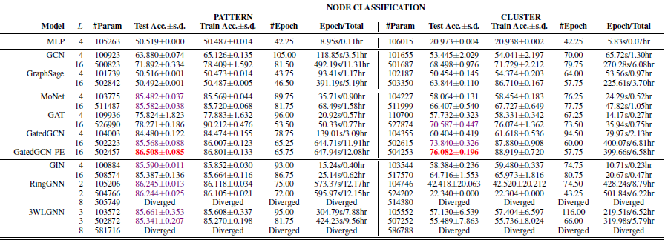
Model Selection

Slide 11
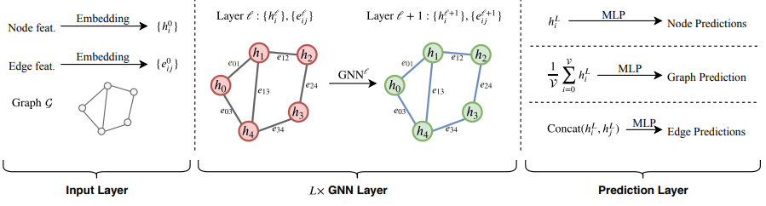
Training Pipeline

Slide 12
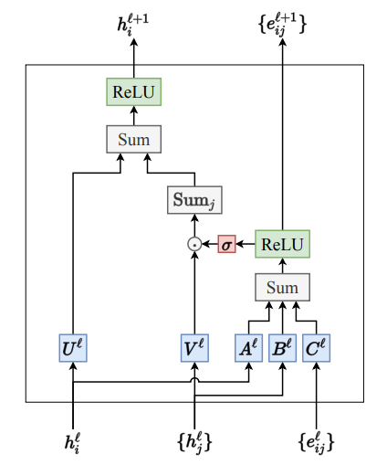
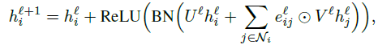
Gated Graph ConvNet (GatedGCN)
Maintains edge features at each layer.
Soft attention mechanism.

Slide 13
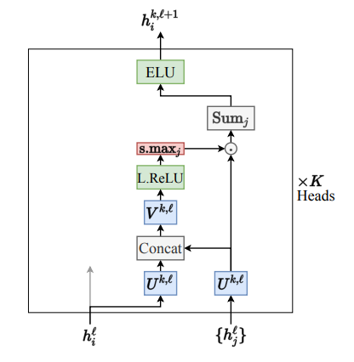
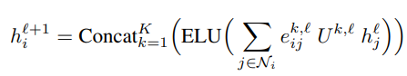
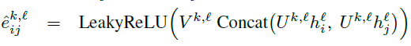
Graph Attention Networks (GAT)
Attention mechanism - anisotropy in the neighborhood aggregation function.
Multi-headed architecture - to increase the learning capacity, similar to Transformer.
The node update equation is given by:
Attention coefficient :

Slide 14
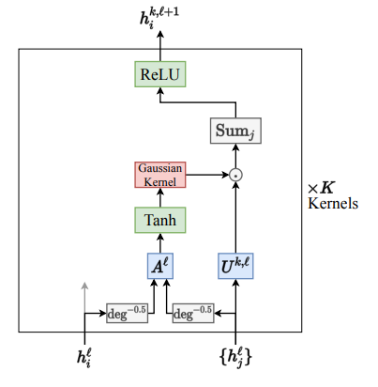
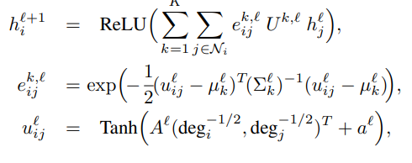
Gaussian Mixture Model Networks (MoNet)
The MoNet Model introduces a general architecture to learn on graphs and manifolds using the Bayesian Gaussian Mixture Model.
The node update equation is defined as:

Slide 15
Experimental Setup
Dataset :
PATTERN
CLUSTER
Models :
GatedGCN
MoNet
GAT
Devices :
Nvidia gtx 1650 - Intel i5 CPU - 16GB RAM
Google Colab - GPU
Tesla P100-PCIE-16GB
Tesla V100-SXM2-16GB
Tesla T4, Tesla K80
Benchmarking Framework :
Data pipeline
GNN layers model
Training & Evaluation function
Network and hyperparameter configurations

Slide 16
Experiments
Parameter Tuning:
Edge Feature FALSE & TRUE
Position Encoding FALSE & TRUE
Number of Layers 4, 8, 16 & 32
Number of Hidden Dimensions 70, 100 & 200

Slide 17
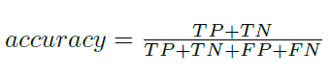
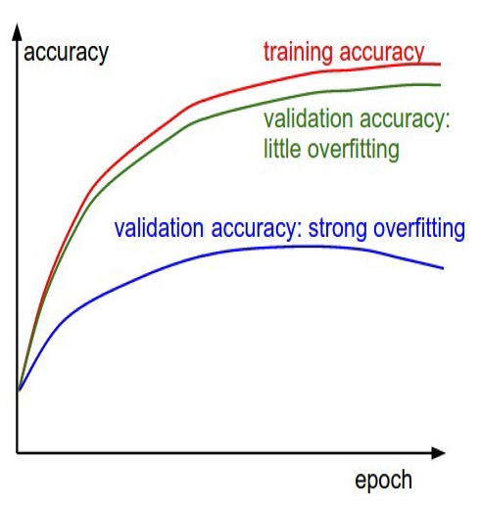
Evaluation Metrics
Where TP - True Positive TN - True Negative FP - False Positive FN - False Negative
Weighted Accuracy with respect to class size.
Accuracy Curve - Progress of Graph Neural Networks.

Slide 18
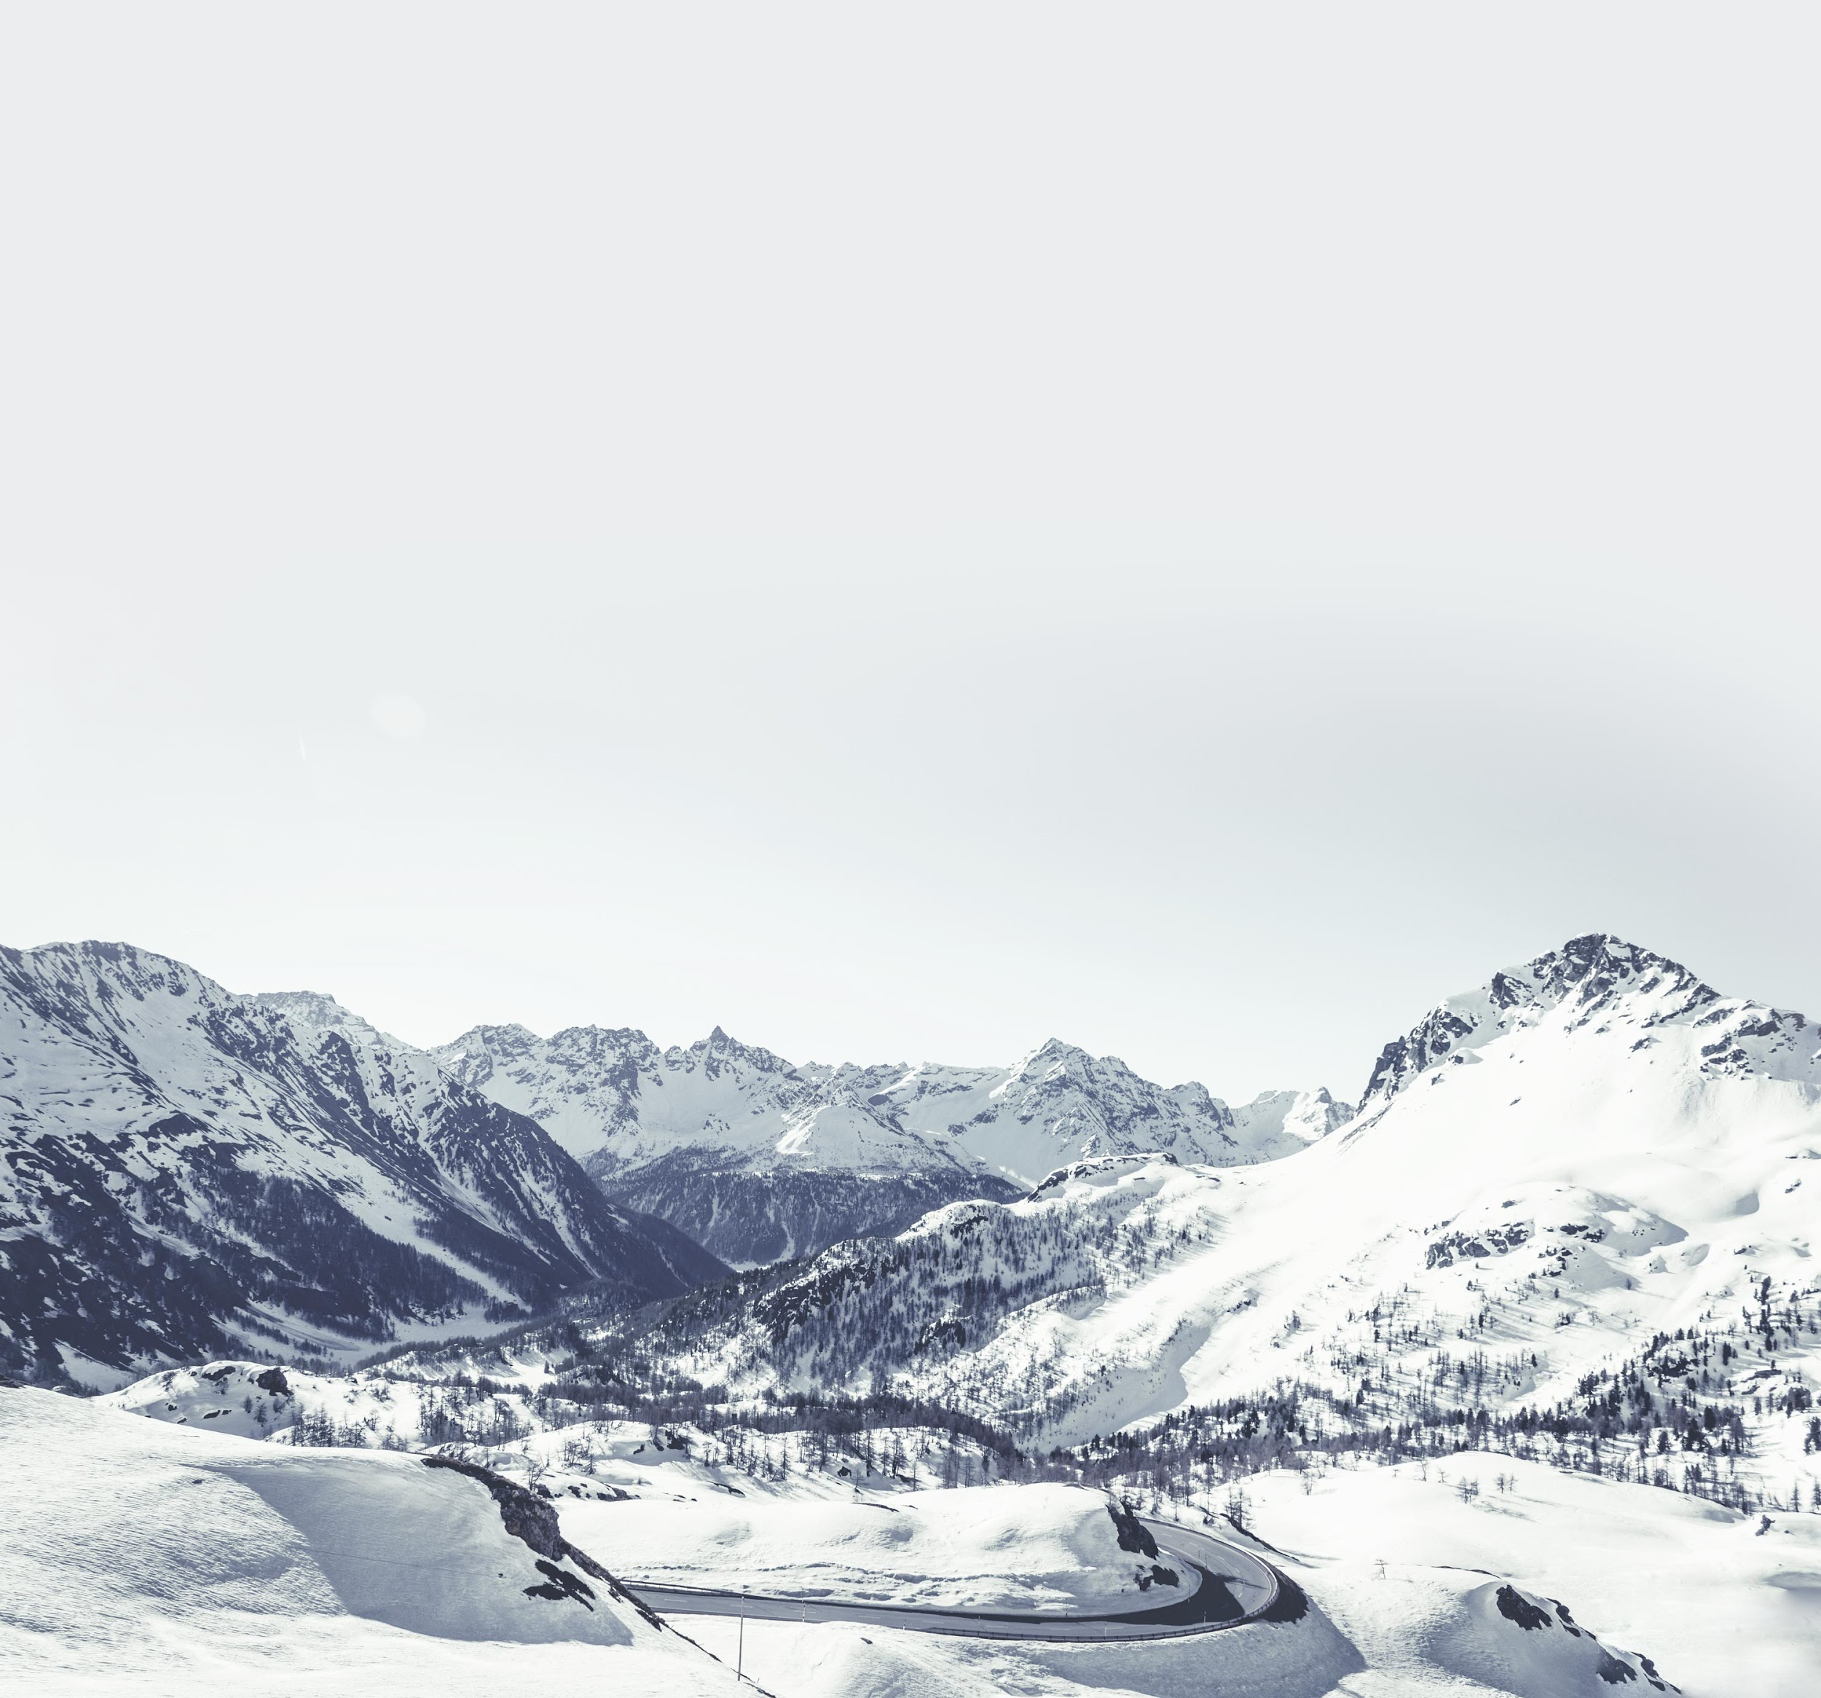
Results

Slide 19
GatedGCN |  |  |  | PATTERN |  |  | CLUSTER
Layers | Hidden Dimensions | Edge Feature | Positional Encodings | Train Accuracy | Validation Accuracy | Test Accuracy | Train Accuracy | Validation Accuracy | Test Accuracy
4 | 70 | false | true | 86.5 | 85.9 | 86.1 | 75.1 | 73.3 | 73.5
4 | 70 | true | true | 85.1 | 84.9 | 85.1 | 75.4 | 73.9 | 73.6
4 | 100 | false | true | 86.6 | 85.9 | 86.1 | 76.3 | 73.6 | 73.5
4 | 200 | false | true | 86.7 | 85.9 | 86.1 | 79.3 | 73.5 | 72.3
4 | 300 | false | true | 86.6 | 85.9 | 86 | 82.3 | 71.3 | 70.8
8 | 70 | false | true | 86.5 | 85.9 | 86 | 78 | 75 | 74.8
16 | 70 | false | true | 86.4 | 85.8 | 85.9 | 82.1 | 75.5 | 75.3
32 | 70 | false | true | 86 | 84.7 | 84.7 | 82.6 | 75.7 | 75.2
4 | 70 | false | false | 84.5 | 84.8 | 85 | 60.5 | 59.1 | 59.3

Slide 20
MoNet |  |  |  | PATTERN |  |  | CLUSTER
Layers | Hidden Dimensions | Edge Feature | Positional Encodings | Train Accuracy | Validation Accuracy | Test Accuracy | Train Accuracy | Validation Accuracy | Test Accuracy
4 | 70 | false | true | 85.9 | 85.5 | 85.6 | 64 | 49.4 | 49.9
4 | 70 | true | true | 86 | 85.4 | 85.7 | 63.7 | 62.9 | 63
4 | 100 | false | true | 85.7 | 85.3 | 85.5 | 65.1 | 63.7 | 63.9
4 | 200 | false | true | 86.1 | 85.3 | 85.5 | 66.5 | 33.8 | 34.5
4 | 300 | false | true | 86.5 | 85.1 | 85.2 | 69 | 63.5 | 63.5
8 | 70 | false | true | 86.4 | 85.3 | 85.4 | 72 | 57.8 | 58.5
16 | 70 | false | true | 86.2 | 85.4 | 85.5 | 76.7 | 50.8 | 51.2
32 | 70 | false | true | 86.6 | 85.3 | 85.3 | 76.7 | 72.3 | 72
4 | 70 | false | false | 85.9 | 85.4 | 85.6 | 63.5 | 62.8 | 62.6

Slide 21
GAT |  |  |  | PATTERN |  |  | CLUSTER
Layers | Hidden Dimensions | Edge Feature | Positional Encodings | Train Accuracy | Validation Accuracy | Test Accuracy | Train Accuracy | Validation Accuracy | Test Accuracy
4 | 70 | false | true | 76.2 | 73.2 | 73.4 | 57.7 | 56.8 | 56.8
4 | 70 | true | true | 76.9 | 73.8 | 73.9 | 57.4 | 56.8 | 56.7
4 | 100 | false | true | 81.7 | 73.8 | 73.7 | 63.4 | 57.4 | 57.8
4 | 200 | false | true | 87.8 | 69.7 | 69.7 | 60.9 | 45.8 | 46.2
4 | 300 | false | true | 92.7 | 53 | 52.9 | 75.9 | 53.9 | 54.1
8 | 70 | false | true | 81.6 | 77.8 | 77.9 | 66.6 | 65.2 | 65.5
16 | 70 | false | true | 83.8 | 78.4 | 78.5 | 71.8 | 68.9 | 69
32 | 70 | false | true | 86.6 | 78.4 | 78.4 | 72.8 | 69.5 | 69.1
4 | 70 | false | false | 75.5 | 73.2 | 73.3 | 57.7 | 56.8 | 56.8

Slide 22
Takeaways
In gated GCN best results are at (4,100) , (8,70) and (16,70) for value of layers and Hidden Dimensions respectively.
Edge feature did not help enhancing the accuracy but positional encoding enhanced the performance of model.

Slide 23
Conclusion
Models considered for Node Classification : GAT, Monet, GatedGCN.
Best Node Classification Model - Better generalizability - Parameter Tuning.
Best Model : 4-layered GatedGCN with 100 hidden dimensions
Second Best Model : 16- layered GatedGCN with 70 hidden dimensions.
MoNet performed good in PATTERN dataset with around 85-86% test accuracy.
But the performance dropped significantly with CLUSTER dataset with test accuracy varying between 34-64%.
Similarly, GAT gave less accuracy in both PATTERN and CLUSTER dataset.

Slide 24
Future Work
Device placement for Machine Learning model dataset.
Minimize execution time of node placement.
To further enhance the performance, Implement :
Operation Scheduling
Operation Fusion

Slide 25
References
Graph Representation Learning Book by Hamilton, William L.
Dwivedi, Vijay Prakash, Chaitanya K. Joshi, Thomas Laurent, Yoshua Bengio, and Xavier Bresson. "Benchmarking graph neural networks." arXiv preprint arXiv:2003.00982 (2020).
Zhou, Yanqi, Sudip Roy, Amirali Abdolrashidi, Daniel Wong, Peter Ma, Qiumin Xu, Hanxiao Liu et al. "Transferable graph optimizers for ml compilers." arXiv preprint arXiv:2010.12438 (2020).
https://wandb.ai/yashkotadia/gatedgcn-pattern/reports/Part-1-Introduction-to-Graph-Neural-Networks-With-GatedGCN--VmlldzoyMDg4MjA
https://wandb.ai/yashkotadia/benchmarking-gnns/reports/Part-2-Comparing-Message-Passing-Based-GNN-Architectures--VmlldzoyMTk4OTA

Slide 26
Thank You

